Slide 1
ICT Programming
Lesson 4:
Working with Data

Slide 2
Objectives
4.4.1: Explain the types and uses of variables in programming.
4.4.2: Explain basic object-oriented concepts.
4.4.3: Describe fundamental Boolean concepts, including Boolean algebra, operators, logic.
4.4.4: Create animated objects using a high-level programming environment (e.g., Alice, Greenfoot) to control their behavior.
4.4.5: Create a simple program that uses animated objects.
4.4.8: Troubleshoot and debug errors in code.

Slide 3
Variables
Used to store data in the computer’s memory
Assigned descriptive names that identify the data
Typically a “field” of data
Example:
X+Y = 7
FirstName = Tom
LastName = Johansson
Must start with a letter, number or _
Can not contain special characters:
$, &, @, #
Case sensitive
FirstName not equal firstname
Order is important
Tom=FirstName, what kind of error is this? Syntax

Slide 4
Declaring / Initializing Variables
Declare: The part of the code that identifies the variable and the data type
Initializing: Giving a variable a beginning value
Example: Score = 0

Slide 5
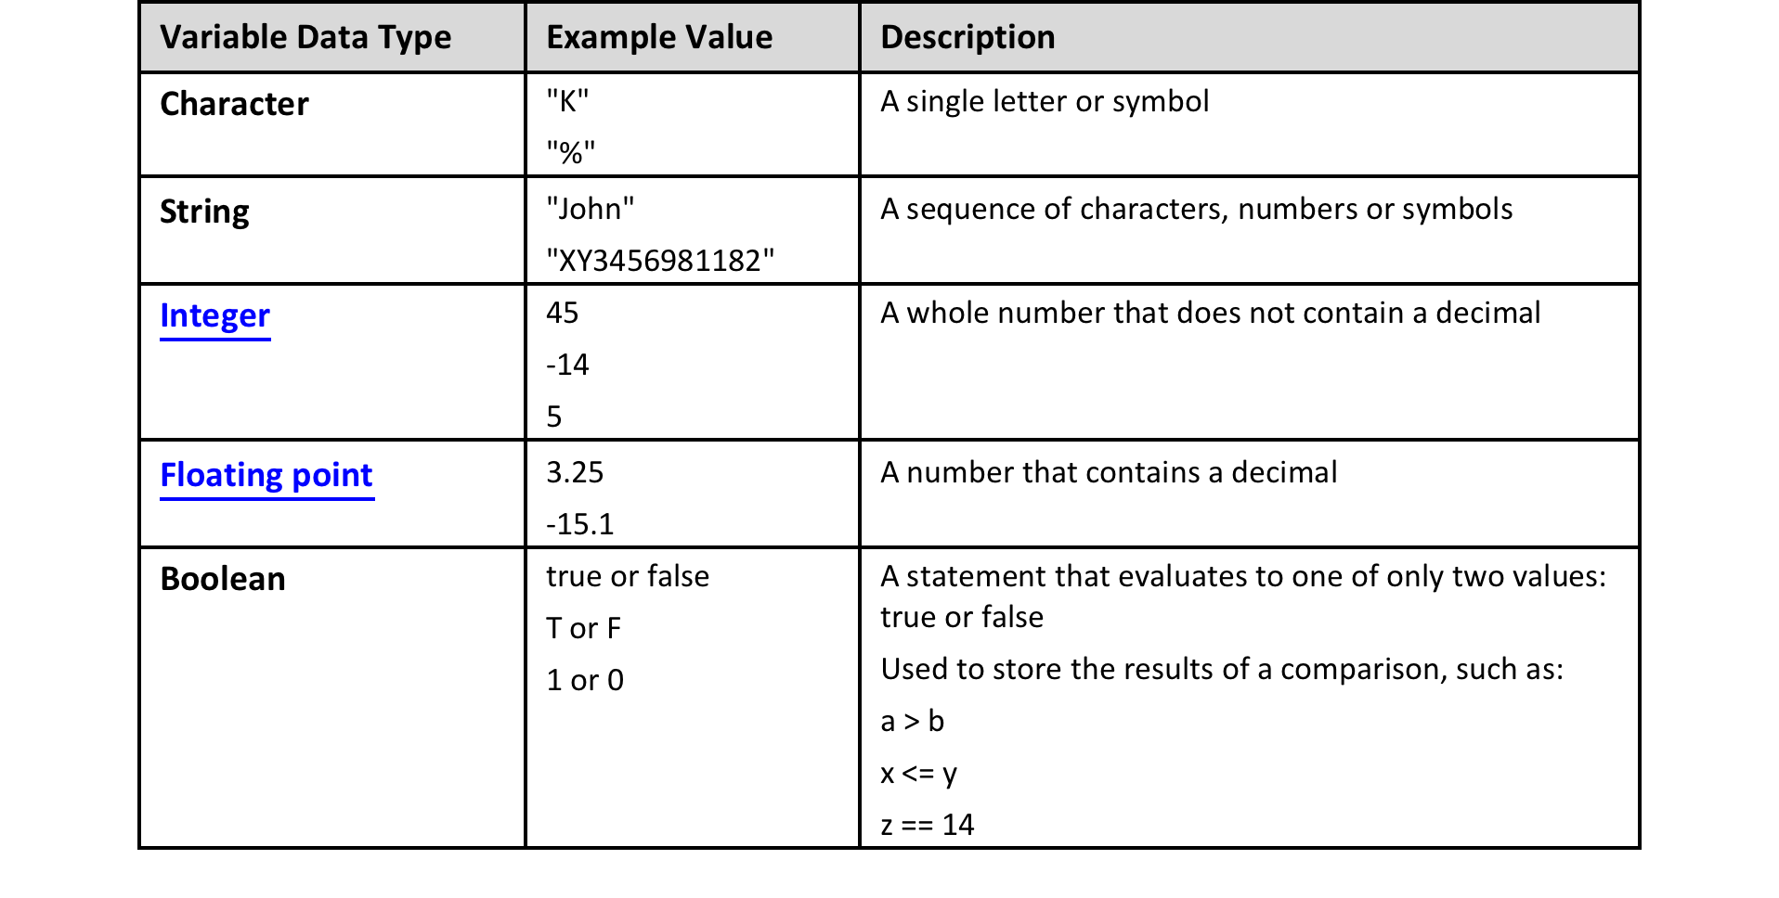
Data Types
Notes:
List games on board. Try to organize as students provide input. You will be categorizing them in a few minutes

Slide 6
Expressions
A combination of symbols that contains at least 1 operand (values) and 1 or more operators
"Hello" + "World" evaluates to "HelloWorld."
Consider the expression
fullName = firstName + " " + lastName (the space enclosed in quotes is used to add a space between the two strings when joined).
If firstName = "John" and lastName = "Smith" then the expression evaluates to fullName = "John Smith"

Slide 7
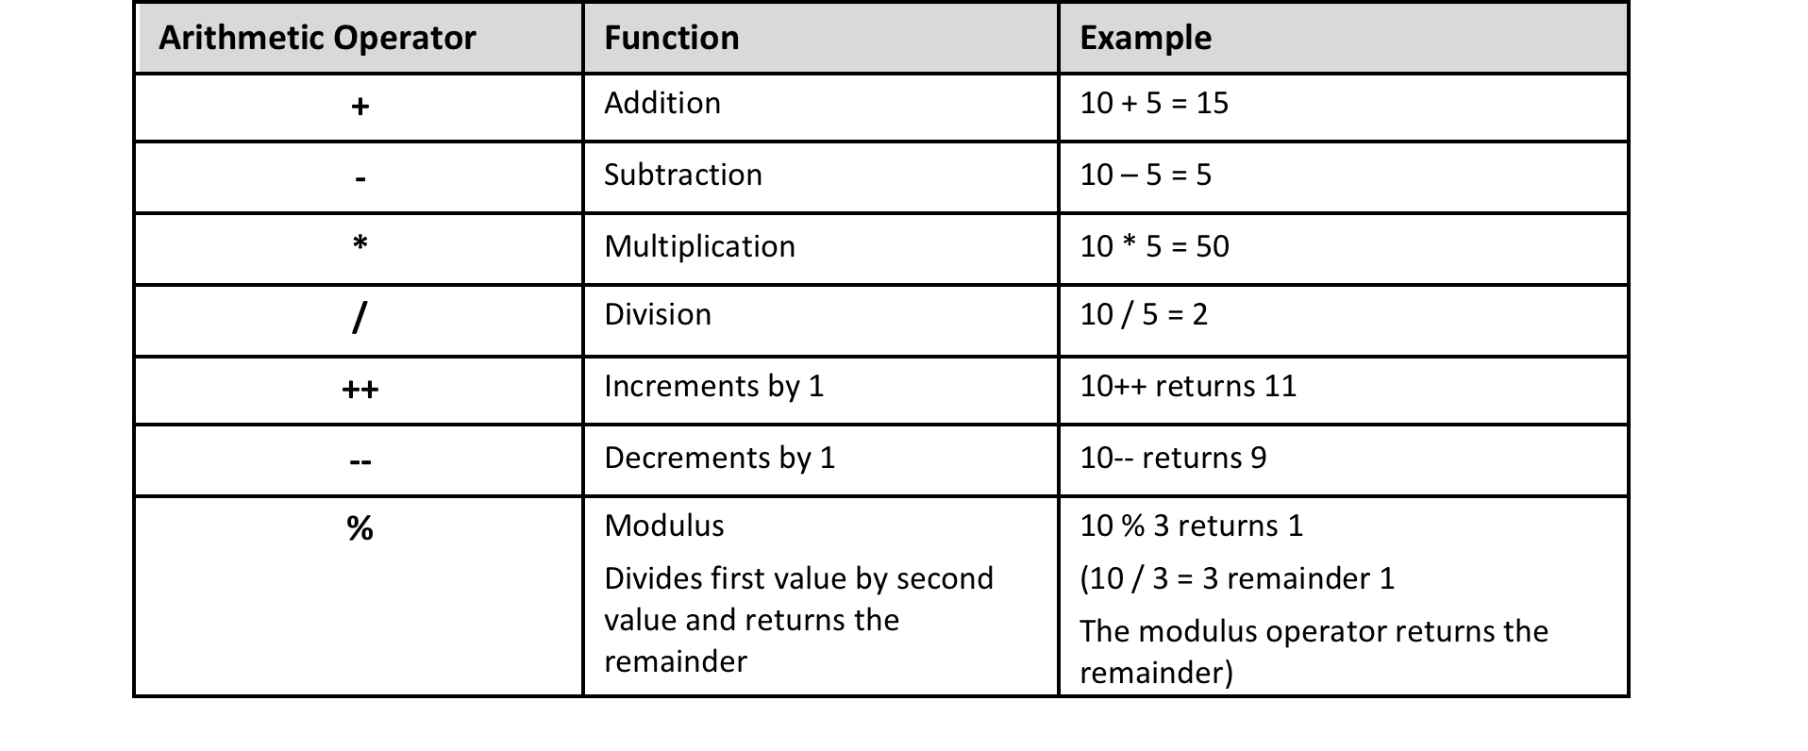
Arithmetic Operators
Perform math
Notes:
List games on board. Try to organize as students provide input. You will be categorizing them in a few minutes

Slide 8
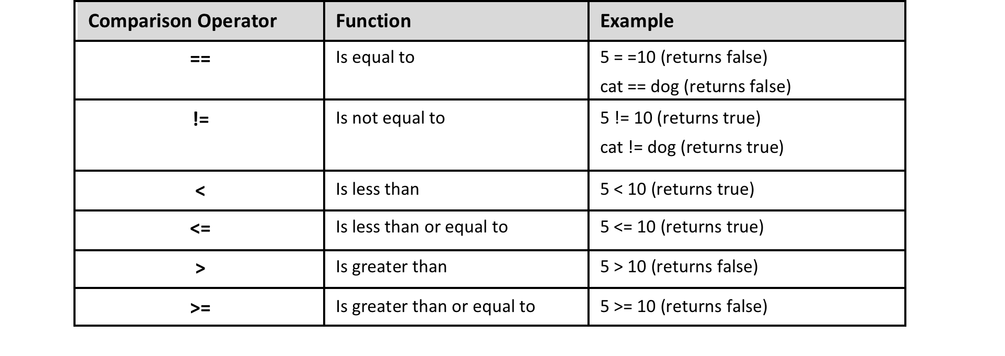
Comparison Operators
Compare variables
Notes:
List games on board. Try to organize as students provide input. You will be categorizing them in a few minutes

Slide 9
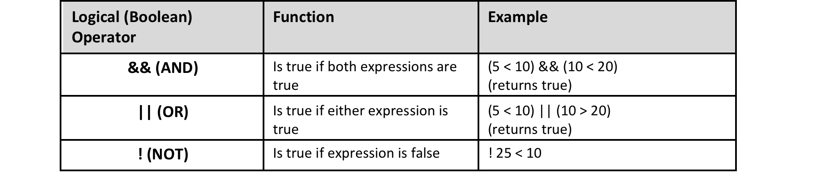
Logical Operators
Boolean – tell what to do “if”
Notes:
List games on board. Try to organize as students provide input. You will be categorizing them in a few minutes

